Slide 1

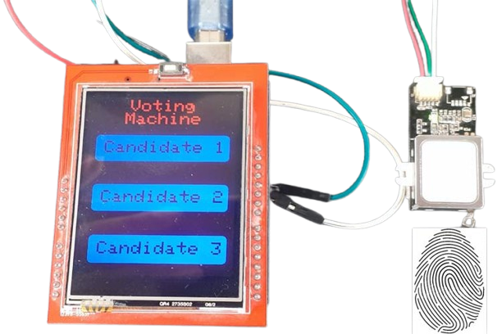
IoT-Based Electric Voting Machine
Candidate Selection Platform
B Tech CSE-IoT (4th year)
Brijesh Nishad : 2101321550026
Ashutosh : 2101321550021
Aayush Pandey : 2101321550001
Submitted to
Mr. Rajat Kishor Varshney
Assistant Professor

Slide 2
List of Content
Introduction
Literature Review
Outcome of Literature Review
Methodology
Hardware Components.
Software Components.
Conclusion
References

Slide 3
Introduction
This document outlines the design, implementation, and setup of an election voting machine that includes fingerprint authentication, candidate selection, and real-time vote monitoring through a web interface built with React. The hardware components consist of a fingerprint scanner, ESP32 microcontroller, and Arduino, while the software architecture allows for real-time updates
Background : The significance of secure voting systems cannot be overstated in today’s democratic processes. This project aims to enhance the security and efficiency of elections.
Motivation : The motivation behind this project is to address vulnerabilities in traditional voting systems and ensure that elections are conducted fairly and transparently

Slide 4
Literature Review
Electronic voting has revolutionized the way electoral processes are conducted from the traditional paper ballot to the more modern systems. Some of the traditional EVMs have led to several benefits like less dependence on paper, quick counting of votes, and reduced human error. There are challenges, however. Issues such as tampering, voter impersonation, and the absence of real-time data monitoring have impeded electoral integrity and transparency. These issues challenge researchers to seek alternative solutions overcoming these limitations while improving the overall efficiency of voting systems.
Besides technical and financial challenges, public perception and acceptance of these systems also play an important role in the success of an IoT-based voting system.

Slide 5
Outcome of Literature Review
The literature review of IoT-based Electronic Voting Machines (EVMs) for candidate selection reveals several important insights, challenges, and opportunities for the future integration of IoT technologies in the electoral process. Below are the key outcomes derived from the review
Technological Benefits.
Automation of the Candidate Selection Process.
Security and Privacy Concerns.
Challenges in Implementation.
Global Trends and Adoption.
Emerging Technologies.

Slide 6
Methodology
IoT-based Electronic Voting Machine (EVM) for candidate selection involves several stages: design, implementation, testing, and evaluation. Each stage incorporates the use of Internet of Things (IoT) technologies to enhance the security, transparency, and efficiency of the voting process.
System Architecture .
Hardware Components.
Software Components.
Process.
EVM Control Portal.
Security Features
Challenges and Considerations

Slide 7
System Architecture
Software Components The software stack includes:
Arduino IDE for programming the fingerprint scanner and candidate selection.
React.js for real-time display of voting results.
Hardware Components The election voting machine utilizes the following components:
Fingerprint Scanner - Used for voter authentication.
ESP32 - Sends data to a real-time web server for vote tracking.

Slide 8
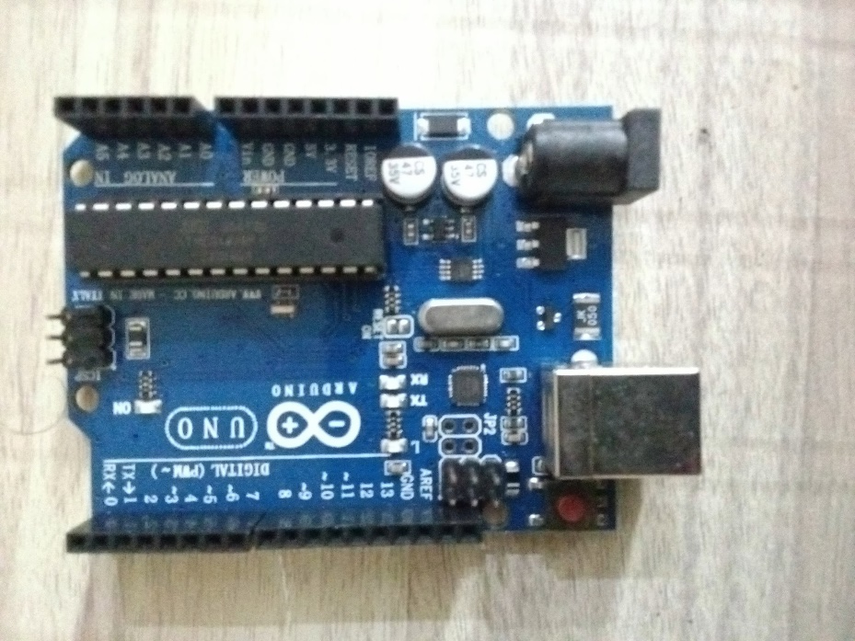
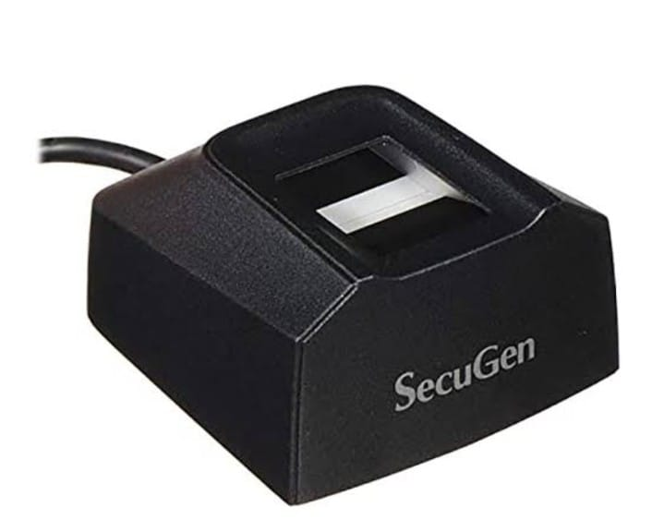
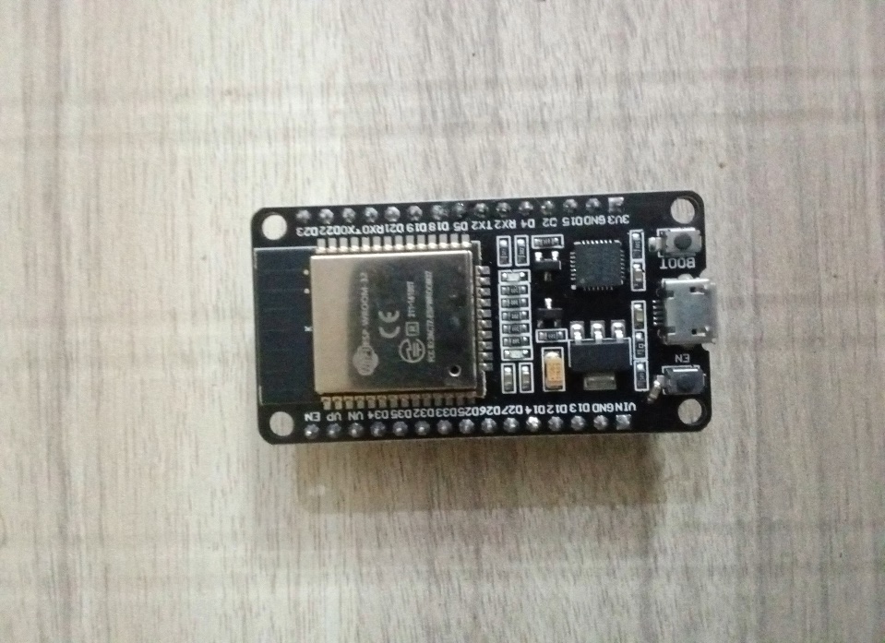
Hardware Components
Arduino Uno
ESP32
Fingerprint device

Slide 9
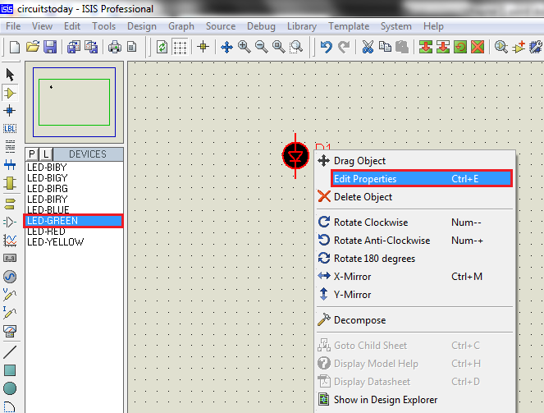
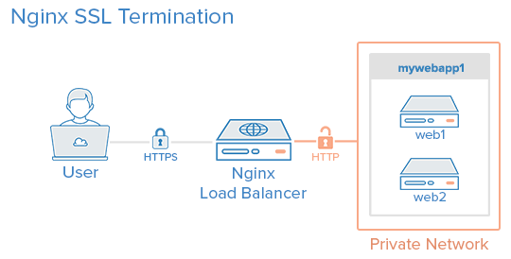
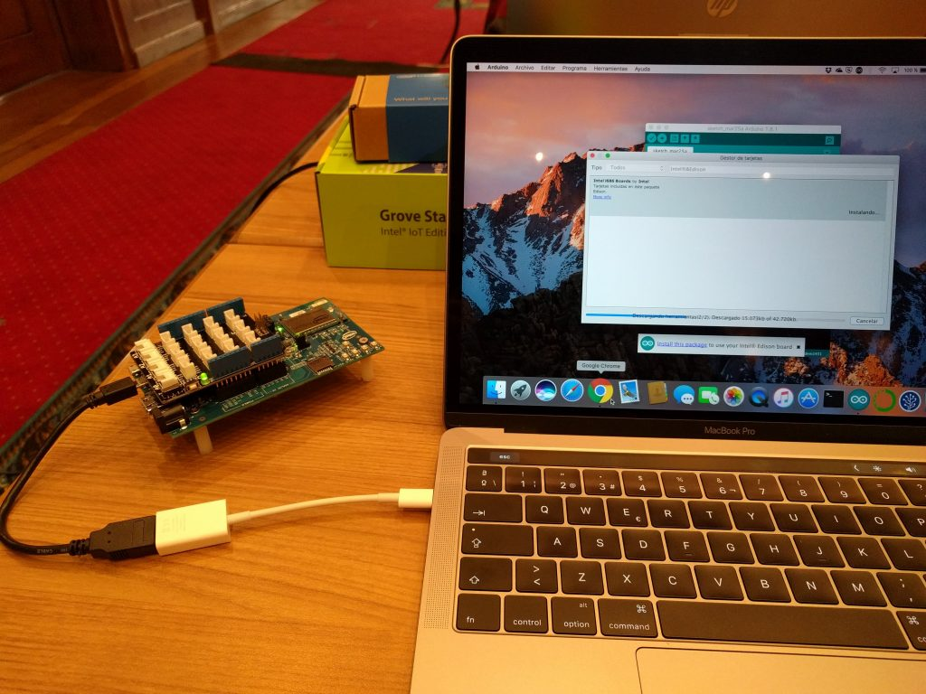
Software Components
Proteus Software
Web
Server
Arduino
IDE

Slide 10
Process
Voting Process
Registration
Authentication
Granted
Initiate
Voting
Collection
Store-Server
Admin Portal

Slide 11
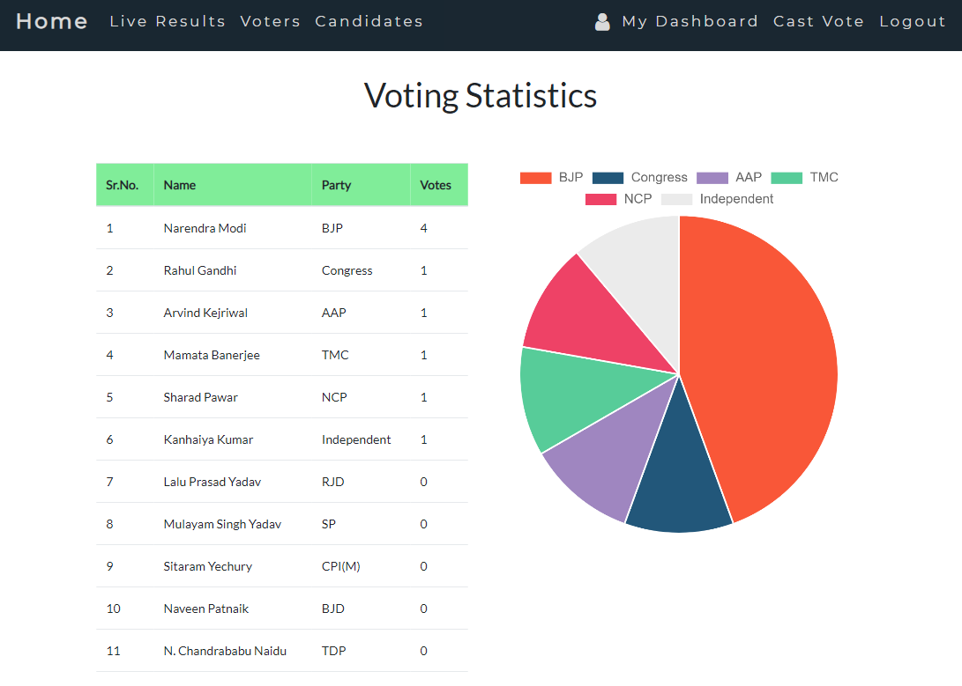
EVM Control Portal

Slide 12
Security Features
Fingerprint Authentication:
Explanation of how tokens authentication works.
Importance of token for ensuring voter authentication.
Password Authentication:
Introduction of password-based authentication for additional security layers.
Importance of strong passwords and encryption techniques.

Slide 13
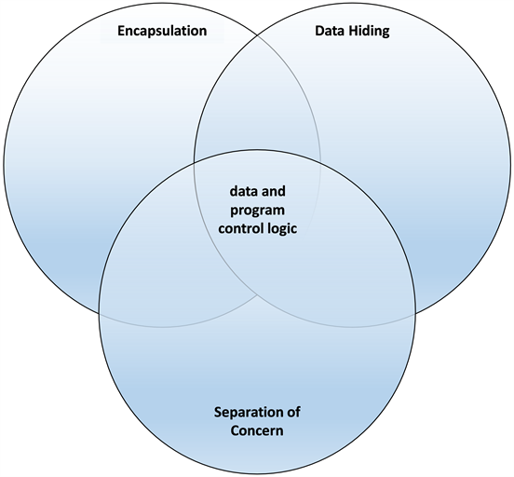
Challenges and Considerations
Potential challenges in implementing IoT-based EVMs.
Addressing concerns related to privacy, data security, and reliability.
Ensuring compatibility and interoperability with existing voting systems

Slide 14
Conclusion
IoT-based EVMs present a promising alternative, offering enhanced security, transparency, and accessibility, potentially transforming the electoral landscape for the better. As technology advances, the integration of IoT in voting systems could lead to more secure, reliable, and participatory elections.

Slide 15
References
[1] A. Singh and S. Sharma, “Design and implementation of iot-based smart evm,” in Proceedings of the 2021 International Conference on Smart Cities and Communication Technologies, pp. 98–105, 2021. Describes the integration of IoT in creating a smart EVM system.
[2] J. Rodriguez, M. Garcia, and F. Batarseh, “The internet of things: Ap- plications, opportunities and challenges,” Journal of Computer Science and Technology, vol. 35, pp. 45–56, 2020. Introduces IoT concepts and potential for improving systems like EVMs.
[3] I. Ahmed, J. Yu, and S. Shah, A Survey of Internet of Things (IoT) in Healthcare Systems and Applications. Elsevier, 2019. Discusses the application of IoT in various fields, including voting systems.
[4] H. Wang and L. Zhang, “Architecture design for iot-based e-voting systems,” International Journal of Computer Applications, vol. 185,
pp. 35–41, 2019. Provides a comprehensive architecture for IoT-based e-voting systems.
[5] M. Gao and B. Xu, IoT Hardware Design and Development. Springer, 2020. Describes the necessary hardware components for IoT devices used in systems such as EVMs.
[6] A. Desai and R. Patil, “Software design for iot-enabled e-voting sys- tems,” in Proceedings of the 2021 IEEE International Conference on Software Engineering and Technology, pp. 99–104, 2021. Discusses the software components and architecture for IoT-based voting systems.
[7] Y. Li and T. Zhao, “Real-time data monitoring in iot-based e-voting systems,” IEEE Access, vol. 9, pp. 1345–1353, 2021. Examines how real-time monitoring and data transmission can improve IoT-based voting systems.

Slide 16
THANK YOU

